Slide 1
Customer Insights and Sales Trends
Analysis of Chip Sales by Segment, Brand & Pack Size
Sidhanta Kumar Behera
May 2025

Slide 2
Here is the full report of tata retail

Slide 3
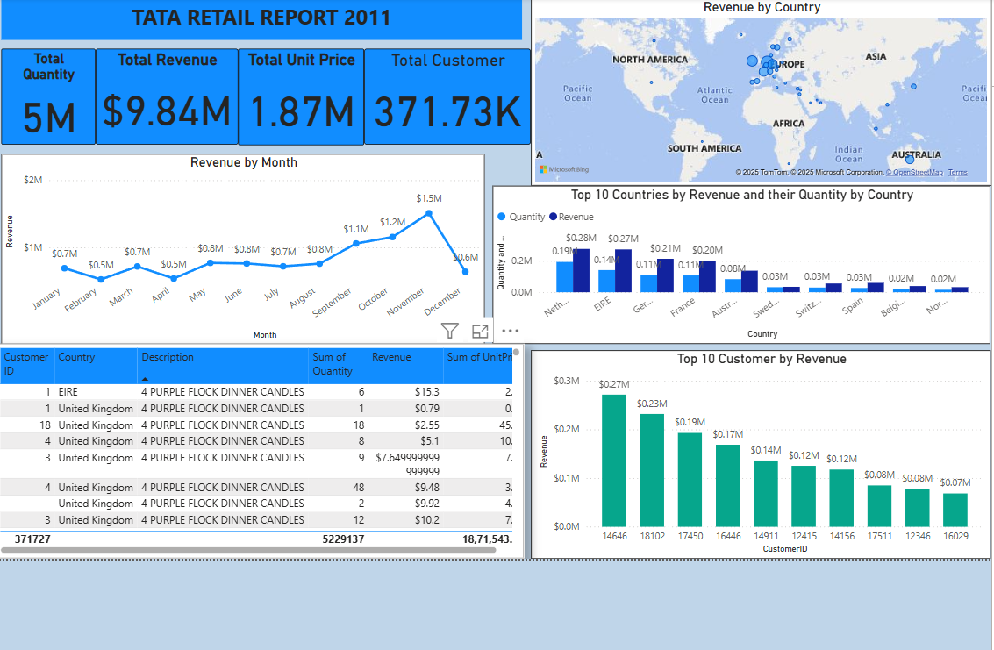
Customer Segment Breakdown of Total Sales
Young Singles/Couples contribute the highest proportion to chip sales, making them a primary customer segment for targeted promotions.

Slide 4
Here is the first question
The CEO of the retail store is interested to view the time series of the revenue data for the year 2011 only. He would like to view granular data by looking into revenue for each month. The CEO is interested in viewing the seasonal trends and wants to dig deeper into why these trends occur. This analysis will be helpful for the CEO to forecast for the next year.

Slide 5
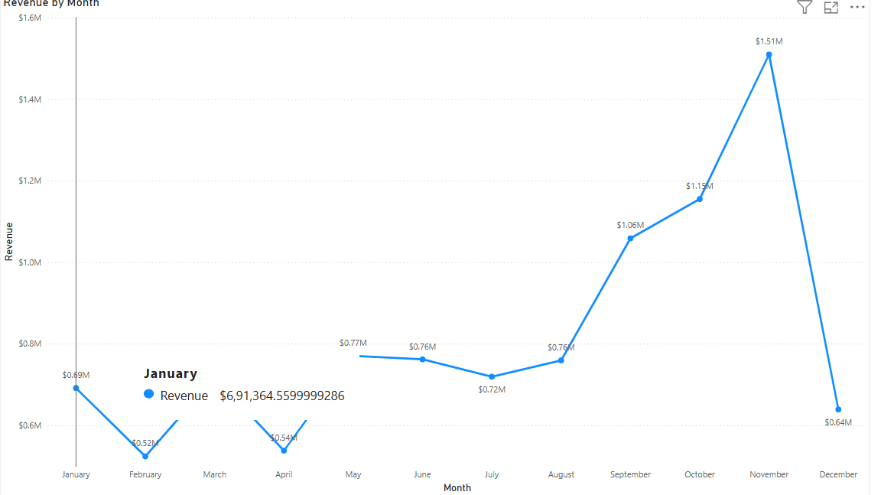
Sales by Customer Segment
Young Singles/Couples lead in total sales, followed by Families and Retirees. These groups should be prioritized in future campaigns.

Slide 6
Here is the second question
The CMO is interested in viewing the top 10 countries which are generating the highest revenue. Additionally, the CMO is also interested in viewing the quantity sold along with the revenue generated. The CMO does not want to have the United Kingdom in this visual.

Slide 7
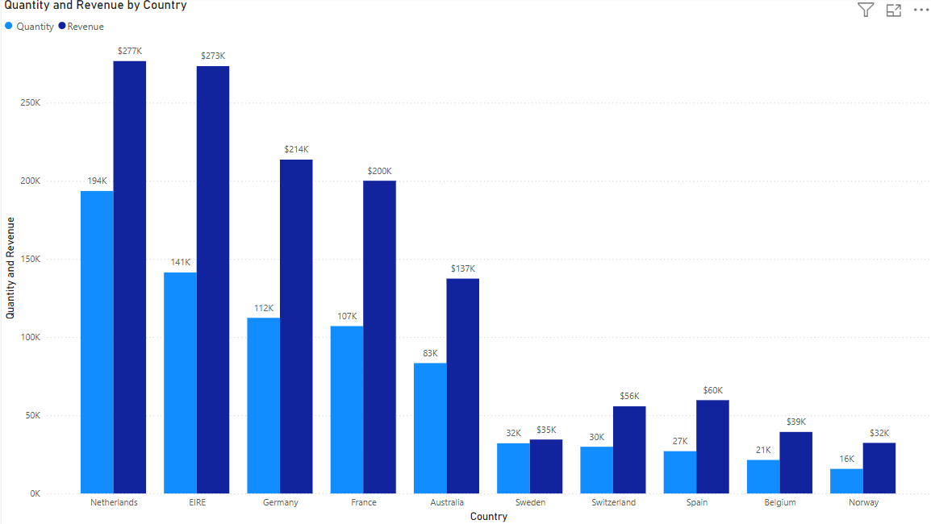
Average Spend per Customer by Segment
Retirees, while fewer in number, spend the most per transaction. Customized premium offerings may be effective for this segment.

Slide 8
Here is the third question
The CMO of the online retail store wants to view the information on the top 10 customers by revenue. He is interested in a visual that shows the greatest revenue generating customer at the start and gradually declines to the lower revenue generating customers. The CMO wants to target the higher revenue generating customers and ensure that they remain satisfied with their products

Slide 9
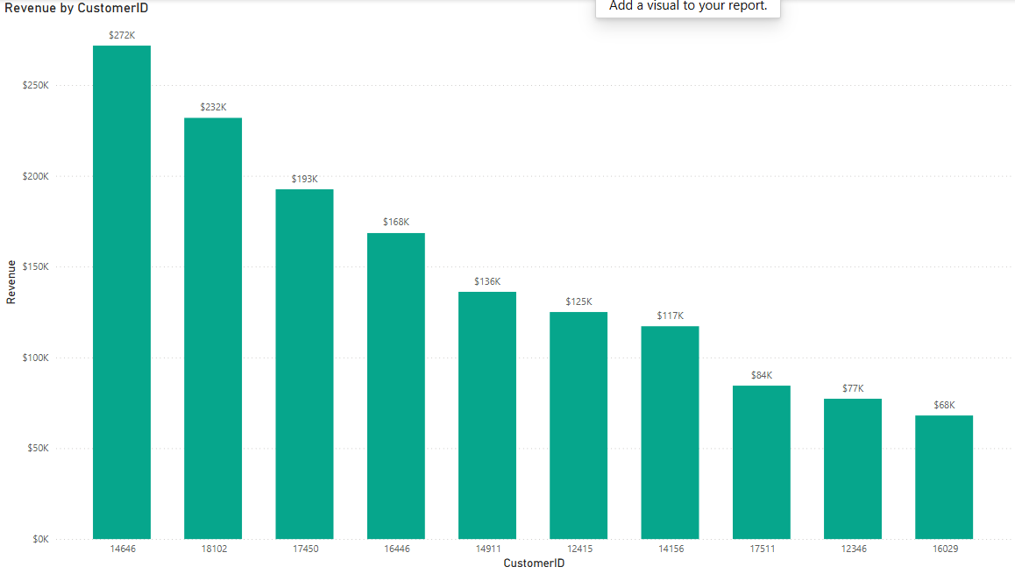
Top Performing Chip Brands
Kettle leads in total sales, followed by Smiths and Doritos. Kettle’s strong performance may justify premium placement or bundling strategies.

Slide 10
Here is the fourth question
The CEO is looking to gain insights on the demand for their products. He wants to look at all countries and see which regions have the greatest demand for their products. Once the CEO gets an idea of the regions that have high demand, he will initiate an expansion strategy which will allow the company to target these areas and generate more business from these regions. He wants to view the entire data on a single view without the need to scroll or hover over the data points to identify the demand. There is no need to show data for the United Kingdom as the CEO is more interested in viewing the countries that have expansion opportunities

Slide 11
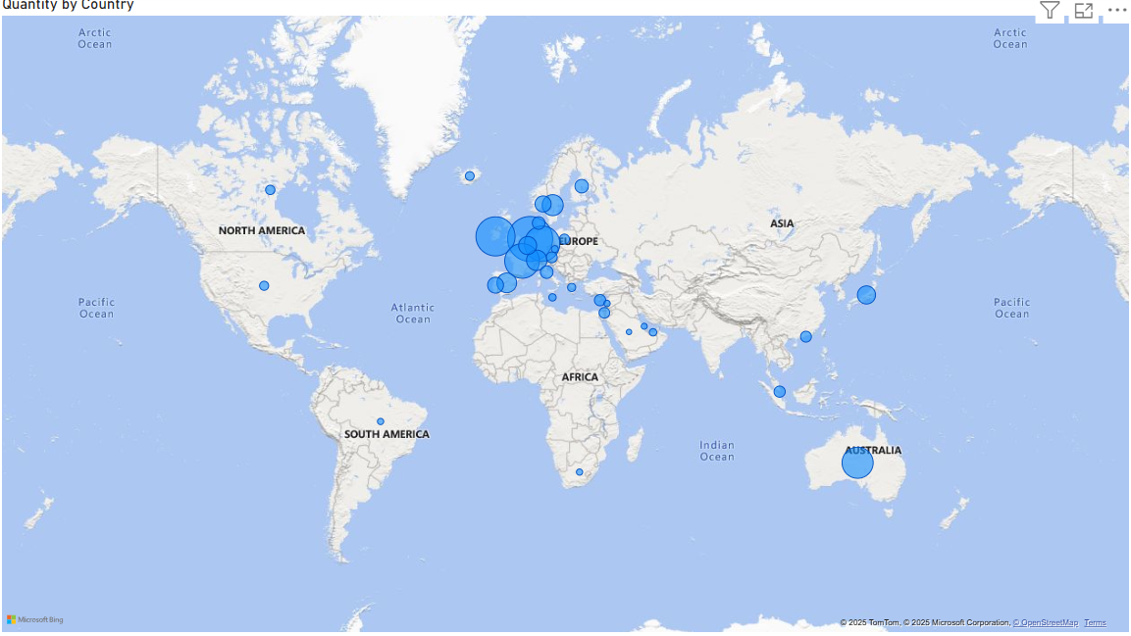
Preferred Pack Sizes by Customers
175g packs are the most popular, indicating they align well with customer preference. Promotions should focus on this pack size.

Slide 12
Key Recommendations
Focus marketing on Young Singles/Couples and Families.
Promote 175g packs, especially for leading brands.
Consider premium chip offerings for high-value customers like Retirees.
Leverage Kettle’s popularity in advertising or bundling.

Slide 13
Thank you

